Slide 1
The Influence of Gender on response to Facebook post types
By: Phoebe Priscilla Amoako

Slide 2
Motivation
Learn more about post types and their relation to gender
Be able to provide more insight into how R could be used

Slide 3
Data Sources
Netvizz, a facebook app

Slide 4
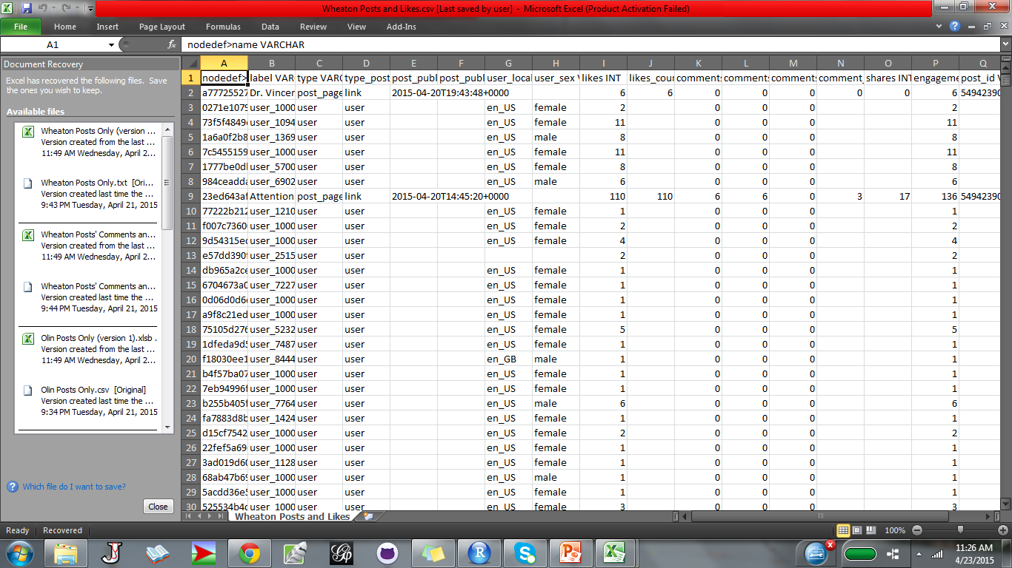
Raw Data

Slide 5
Data Exploration –Challenges
Cleaning
What to look for in about 500 cells in Excel!

Slide 6
Research Question
Do the types of posts on Facebook encourage a particular gender type response?
Which post types do the audience find more engaging?

Slide 7
Methods Used
Graphs, Graphs, Graphs
Creating of functions using R

Slide 8
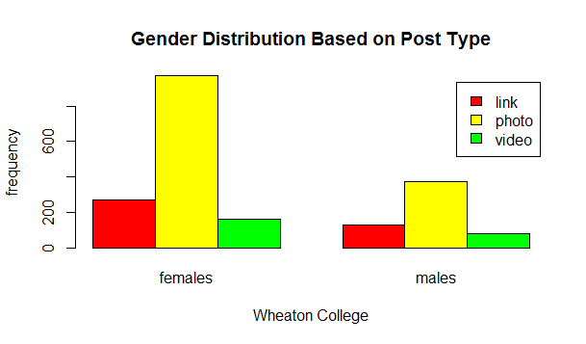
Results – Wheaton College

Slide 9
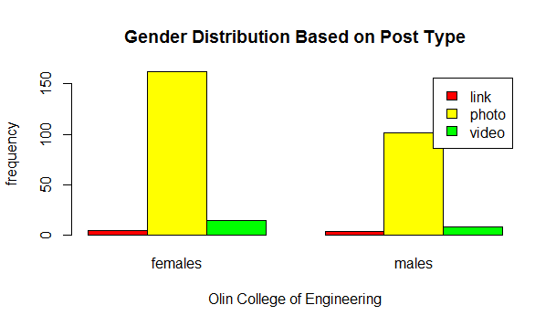
Results – Olin College of Engineering

Slide 10
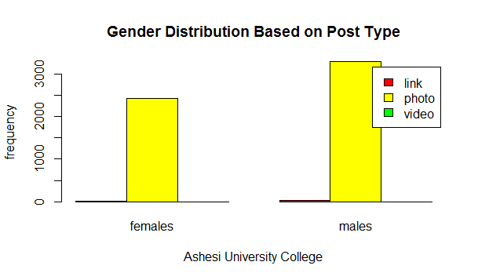
Results — Ashesi University College

Slide 11
Conclusions
Females are more active on Facebook in all three colleges
Posts are more interactive. Videos and links often divert students to other pages and take more time
Ashesi seems to be on the right path with post types

